Slide 1

WAY TO ENTERPRISE
Java

Slide 2
Agenda
Web architecture
Setup software
Datatype
Enum
Array
Init Object
Assignments
Copyright © VTI Academy All Rights Reserved

Slide 3
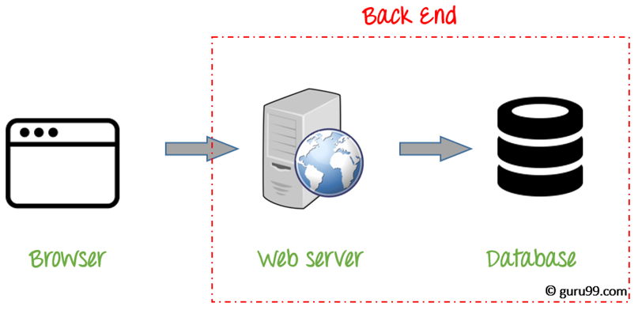
Web architecture

Slide 4
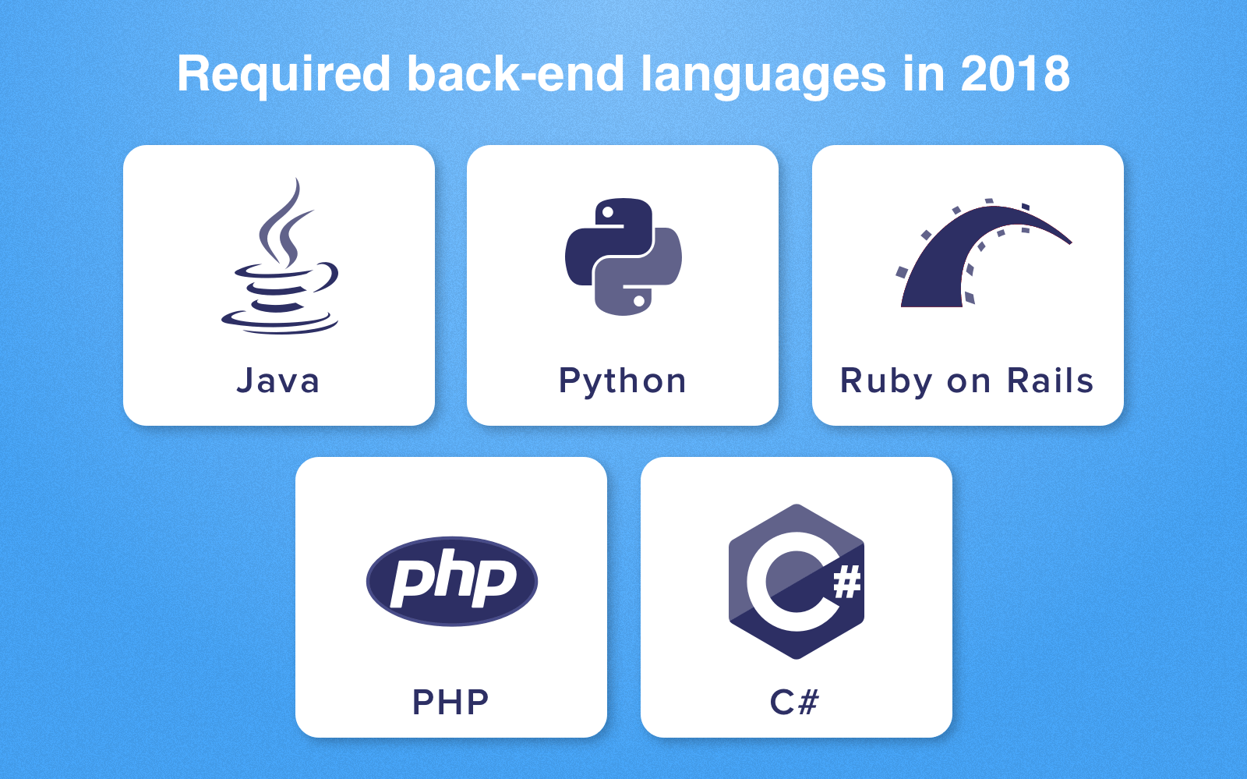
Popular Language

Slide 5
Setup Software
JDK
Eclipse IDE

Slide 6
Datatype
Primitive
String
Date
Enum
Array

Slide 7
Primitive
Integer
Real number
Characters
Boolean

Slide 8
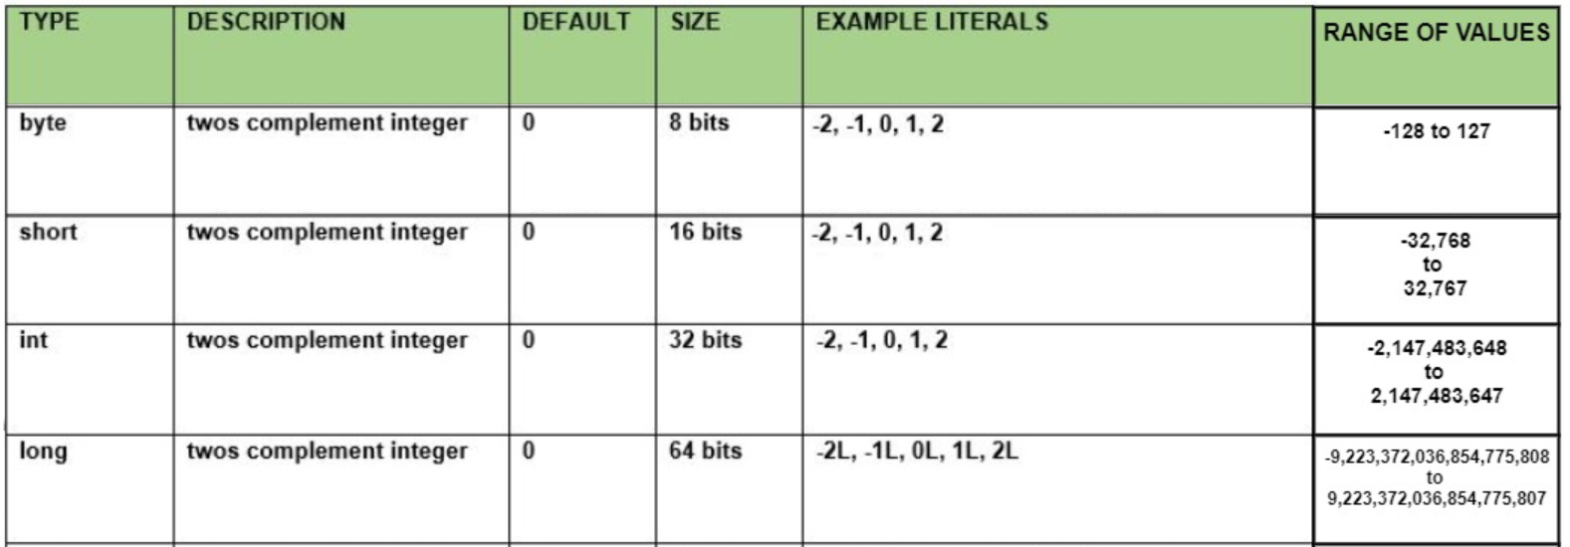
Integer

Slide 9
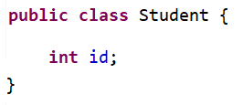
Example
Ex:

Slide 10
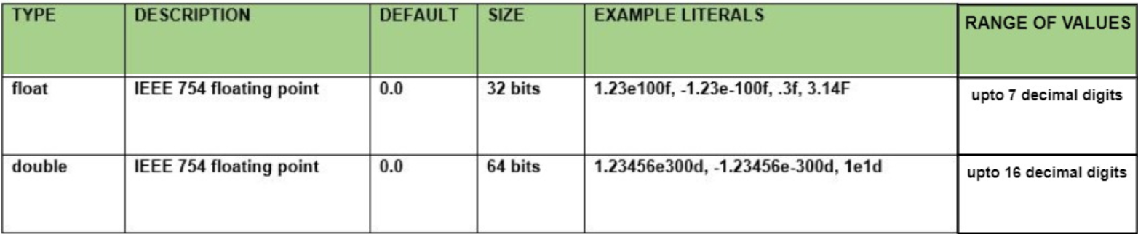
Real Number

Slide 11
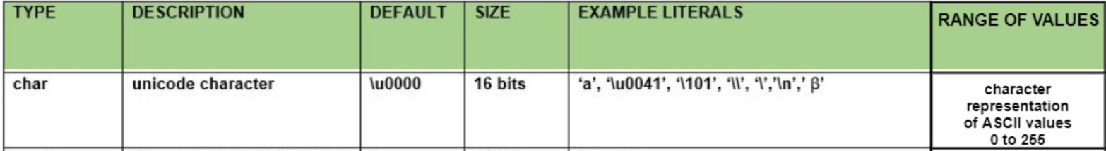

Characters
Char
String

Slide 12
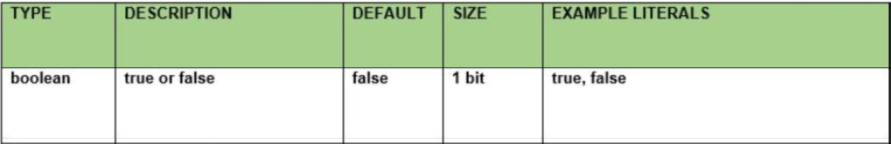
Logic

Slide 13
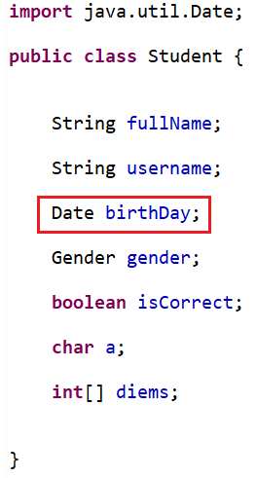
Date
Date
LocalTime

Slide 14
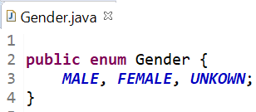
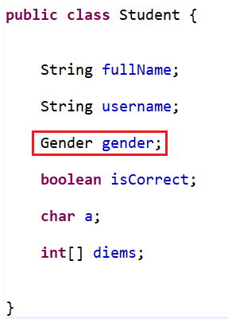
Enum

Slide 15

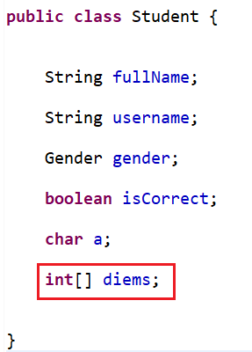
Array
Init
EX:

Slide 16
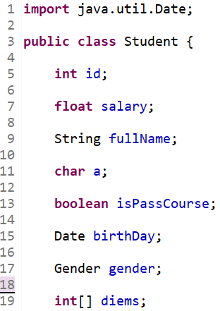
Naming rules
Property is noun
Capitalize each character of the word except the first word
The boolean data type has the first character is "is" character
Enum: Capitalize all characters

Slide 17
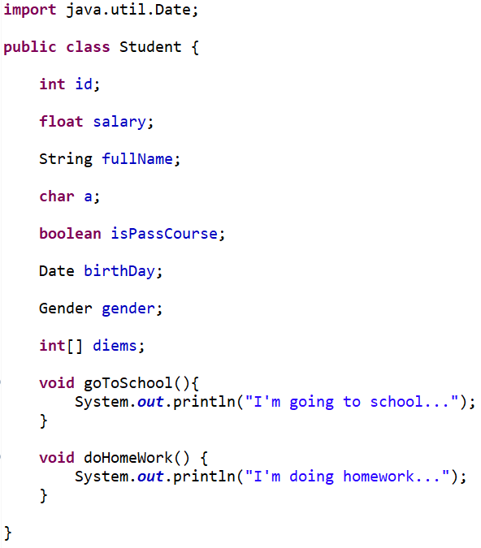
Object
Property
Method

Slide 18
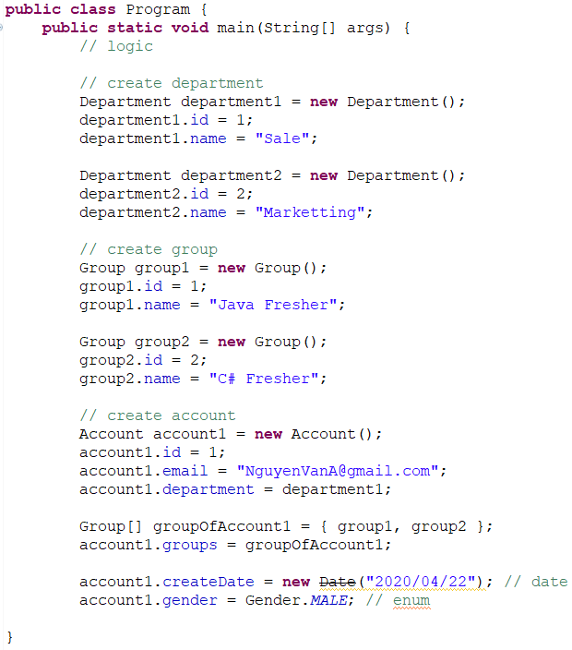
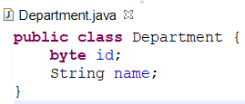
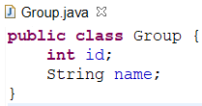
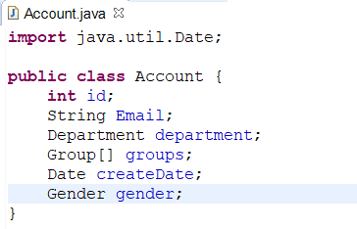
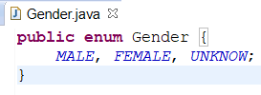
Init Object

Slide 19
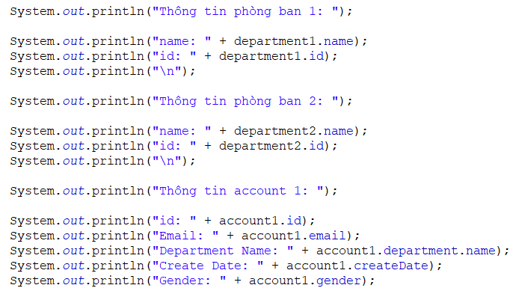
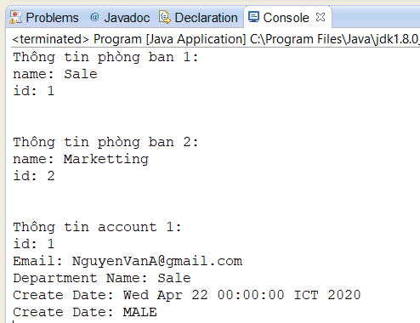
Print value

Slide 20
Q & A
Copyright © VTI Academy All Rights Reserved

